Slide 1
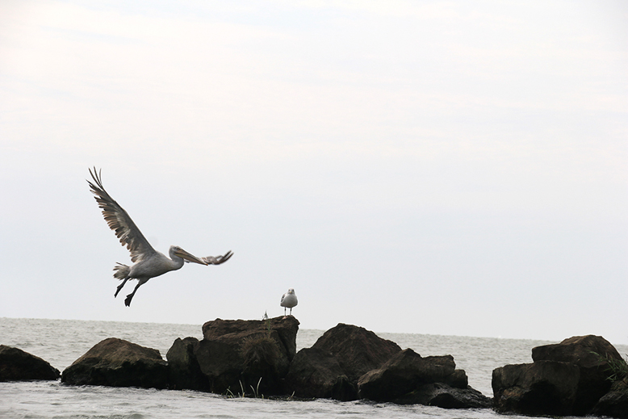
Integrated Planning and Design
Thursday, April 9, 2020
Location:xxxxxxxxxxx
Group members:
Xxxxxx, yyyy, xxxx…..

Slide 2
Presentation guidance
Each team presents its findings on 10 slides according to the structure of this template
Do not switch to wide-screen PPT formats (no proper display in Adobe Connect)
You have one minute presentation time for each slide, sometimes two minutes
Each team member needs to present a part of it
Make sure that you have a coherent sequence, you should do a rehearsal in advance
Make sure that everyone has a functioning microphone/headset
Your total presentation time is 20 minutes. 10 min presentation + 10 min discussion. Students working individually have 15 minutes in total.
Make sure that you keep the time limits, you will otherwise be stopped by the moderator.
Your presentation will be evaluated, it is a compulsory part of the assignment.

Slide 3
What are your goals?
Which goals have you derived from your landscape assessment?
Please show in how far your goals are supporting the sustainable development goals (could be one or several SDGs)
1 minute

Slide 4
Your spatial vision
Present the title of your project
Show with a schematic map how your strategy translates into the actual territory (the overall concept)

Slide 5
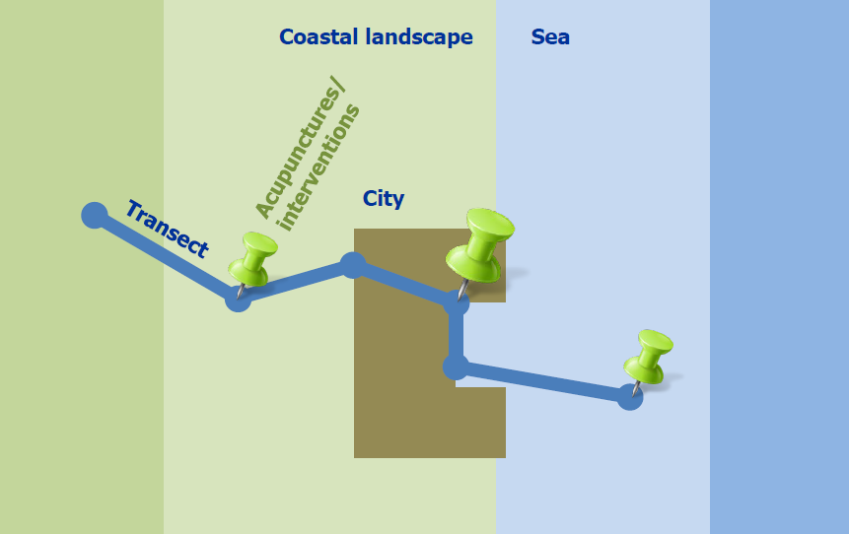
Your transect
Specify a transect through your area with areas for intervention/acupuncture

Slide 6
Your interventions/acupunture (1)
Visualise your interventions on two slides

Slide 7
Your interventions/acupunture (2)
Visualise your interventions on two slides

Slide 8
Partnerships and governance (1)
For implementing your vision: Which partnerships are needed? Which governance model is required?
Who needs to act and how? Draw and explain a change/process model/timeline
Which resources are needed? On which assets can you build?

Slide 9
Partnerships and governance (2)
For implementing your vision: Which partnerships are needed? Which governance model is required?
Who needs to act and how? Draw and explain a change/process model/timeline
Which resources are needed? On which assets can you build?

Slide 10
Process Reflection
Reflect in your team on the outcomes of your study
Which limitations were you facing? What have you learnt from each other? What would you do differently next time?

