Slide 1
TELOS Landscape Economy Seminar Assignment 3 Landscape System Modeling
Presentation / reporting template

Slide 2
Template for Assignment 3 – Landscape System Modeling
This template supports your final presentation for the TELOS seminar.
It is just a content framework. Feel free to give it your personal identity and layout.
The assignment itself is described in detail on the TELOS website:
https://telos.hfwu.de/index.php?title=Assignment_3:_Landscape_System_Modeling
We expect the following content
A brief introduction to the local landscape sustainability challenge you want to address by your system design (result of your system analysis, assignment 2)
A spatially-explicit translation of your vision to your local landscape context, for example in the form of a creative & visionary master plan.
A social business model canvas that explains how you are going to establish an innovative approach in your landscape. This may take the form of new product, a new service, a new cooperation model or whatever variant of those.
A critical evaluation of the potential impact of your innovation.
This template may help you to prepare your presentation.
Presentation time: January 23, 2023, 16 00 – 17 30 CET
Submission: January 23, 2023, 23 55 CET

Slide 3
Start from the local landscape sustainability challenge you want to address (max. 2 slides)
You probably have identified more than one challenge.
You may name several but please focus on the one(s) you want to address and resolve with your innovative system design.
Explain which impact the challenge has and which sustainability aspects are affected (you may refer to the UN SDG‘s or other sustainability indicator schemes).
Challenges might be environmental, social, cultural or economic.
These dimensions are typically interelated.

Slide 4
Your vision (one slide)
Give us a visual idea of how your alternative future will look like.
No stereotype visuals or placeholders without relation to the site!
Show a visualisation that develops out of the local landscape context.

Slide 5
Your idea (one slide)
What is the name of your innovative idea?
What is it (a product, a service, a new cooperation, a tool….?)
Why is it a solution to the landscape sustainability challenge you have identified?

Slide 6
In the following, you will explain your idea step by step, using the main elements of the social business model canvas Complete the business model canvas (next slide), but do not focus on the canvas per se in the presentation. You can explain it step by step with the slides that follow. You find the model also with explanatory notes and a good practice case at the end of this template. The theory behind has been explained in class, here is the recording: https://ilias.hfwu.de/goto.php?target=cat_40967&client_id=hfwu

Slide 7
(Social) Enterprise or charity / community based organizations
Mission Statement
Key-Partners
Key Processes
Value Proposition
Key-Products &
-Services
Customers
Beneficiaries
Key Resources
Channels
Cost-Driver
Revenue-Driver
Customer & Beneficiary Input
KPI (Key Performance Indikator)
Social & Environmental Impact / Impact on Beneficiaries

Slide 8
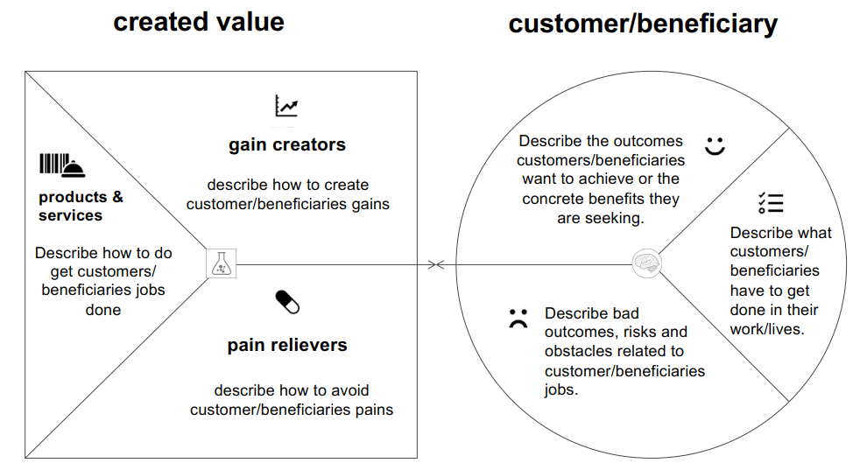
Value Proposition (one slide)
Define which values do you want to create for whom. Be as specific as possible.
Understand your customers / beneficiaries gains, pains and jobs!
Tutorial: https://www.youtube.com/watch?v=ReM1uqmVfP0

Slide 9
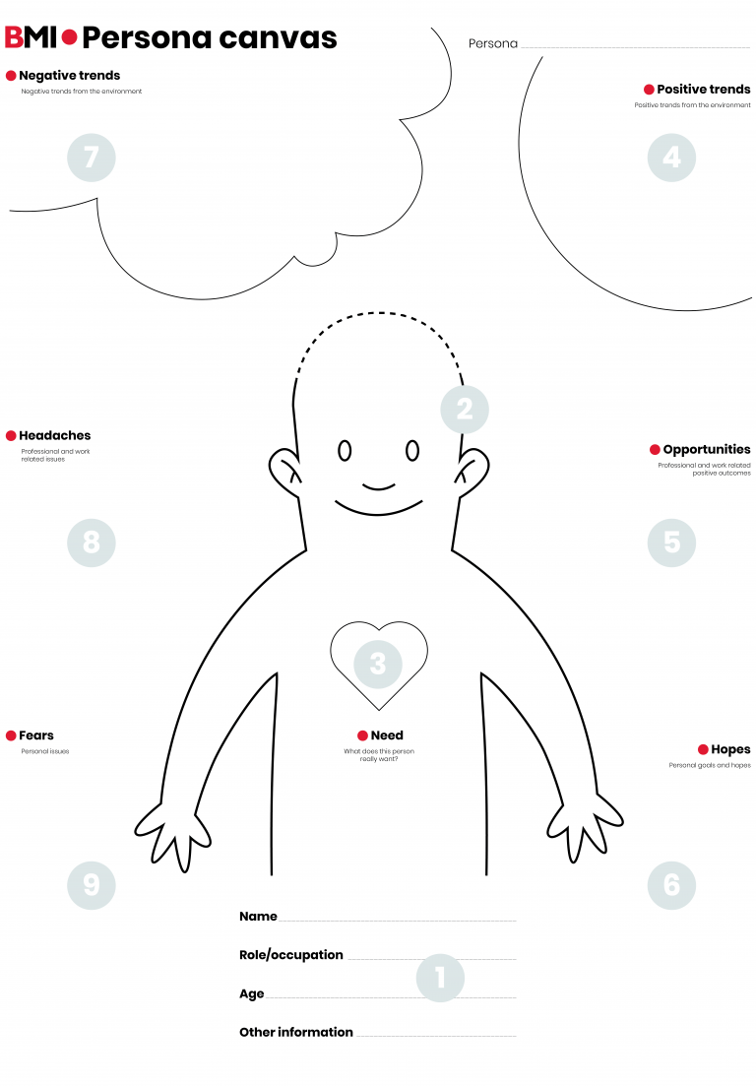
Customers & Beneficiaries (2 slides, one for each persona)
Develop a persona for a typical customer and a typical beneficiary.
This persona canvas is just an example
You are also welcome to use another one.

Slide 10
Key-products and -services (1 slide)
Explain the most important products or services to inspire and win/retain customers. What is the particular benefit for your target group?

Slide 11
Channels (1 slide)
Which channels are you using to get in touch with your customers and to sell your products and services?

Slide 12
Key Processes (1 slide)
Develop a process diagram of one of the key processes of your business model.

Slide 13
Key Resources (1 slide)
Describe one of the key resources of your business model. How can you ensure that this resource is permanently available and will be developed further?

Slide 14
Key Partners (1 slide)
Describe one of the key partners of your business model. How can you ensure that this partner will cooperate with your organization? Which target conflicts might arise?

Slide 15
KPI: Key Performance Indicators (1 slide)
Define and explain three KPI to measure the success of your business model according to your mission statement and value proposition.

Slide 16
Social and/or Environmental Impact (1 slide)
Coming back to the landscape challenge you want to address: What will be the long term impact of your initiative?
What are relevant indicators of success?
How do you plan to measure and report this impact?
Tell your story in brief: How will this impact solve the landscape sustainability challenge you want to resolve?

Slide 17
First step (1 slide)
What is the first step towards implementing your vision?

Slide 18
Annex
Supporting material: Social Business Model Canvas with explantory notes
Supporting materis: Good practice of completed Social Business Model Canvas
Materials discussed in class: https://ilias.hfwu.de/goto.php?target=cat_40967&client_id=hfwu

Slide 19
Guideline for your Social Business Model Canvas
(Social) Enterprise or charity / community based organizations: „name“, „legal form“, „location“, „founding year“, „founders“, „main field of activities“„no. of employees“. Note: This canvas can also be used for describing, analysing and developping business modells for more charity and community based orgainsations as long there are costs to cover and revenue streams to secure.
Mission Statement: company's purpose as a way of unifying the organization. A combination of what your business or nonprofit does and how and why it does it, expressed in a way that encapsulates the values that are important to you. Example: “Fair Collection”: We employ disadvantaged people in developing countries. Together we create and sell jewelry - providing dignified wages and holistic social programs.
Key-Partners
Which partners, who are not in the direct sphere of influence of the company are important for the success?
Examples: central suppliers, advertising online platform, municipality, donators, politicians, …
Key Processes
Which processes are of central importance for the value creation of the company?
Examples: recruiting, training & education, crowd funding,
Value Proposition
What characterizes the value added of the company?
What makes it "different“ / "special"? Why do customers become "fans"?
What are the special benefits you create for the customers / beneficiaries?
Example: “Fair Collection” We create and sell attractive genuine and costume jewelry.
Key-Prod. & -services
Which activities & services inspire the customers and help to win/retain them?
Examples sustainbility-standards, levels of creativity & innovation
Customers
Who do you address?
Criteria to describe the target group: demo-graphic, socio-economic psychographic, market behaviour
Personas help to explain the target group more comprehensibly
Beneficiaries
See customers
In addition: What are their needs, why are they in need
Key Resources
Which (in)tangible input factors determine the success of the SE.
Examples: data, know-how employees, brand reputation, location, support of volunteers
Channels
Which ways to your customers do you use and combine?
Examples: Shop, online-shop, social media, platforms, weekly markets
Cost drivers: What are the most important cost items? Which ones have a strong dynamic? Which ones can be decisively influenced? (raw material, rent, online marketing, personnel, interest, ...)
Income drivers: What are the most important sales drivers? Which ones have a strong dynamic? Which ones can be decisively influenced? (products, services, online shop, events, donations, …).
Customer & Beneficiary Input: In what way do customers and / or beneficiaries contribute to the value creation? (Examples: acceptance of higher prices or unconvenient processes, supporting compaigns, ...)
KPI (Key Performance Indikator): With which key figures do you want to measure the success? Link them to your mission statement and value proposition as well as to different areas of the company (e.g. finance, customers, development, processes, resources).
Social & Environmental Impact / Impact on Beneficiaries: Which effects does the companies work have on the Sustainable Development according to UN SDG and with regard to the beficiaries needs (payment, education, health, quality of live, participation, …)

