Slide 1
If we told you the most
valuable asset on Earth was soil…
Would you agree?

Slide 2
William O’Brien,
former CEO of the Hanover Insurance Company

Slide 3
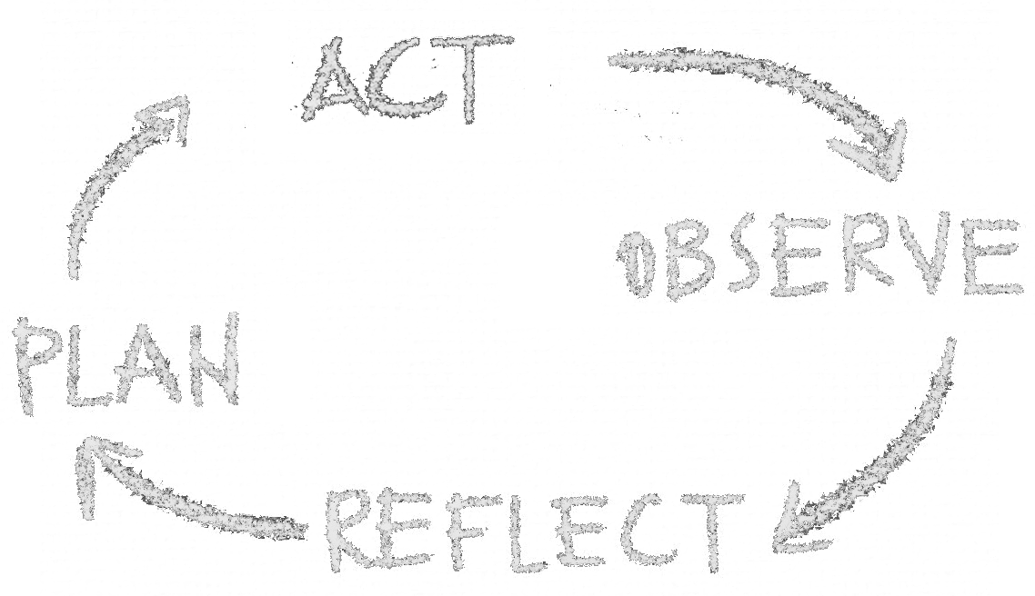

Slide 4
Levels of Listening

Slide 5
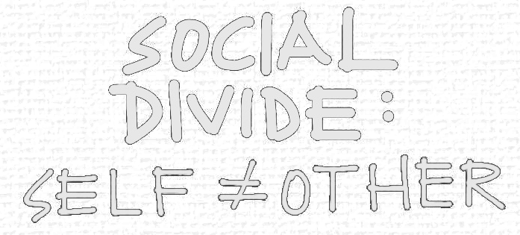
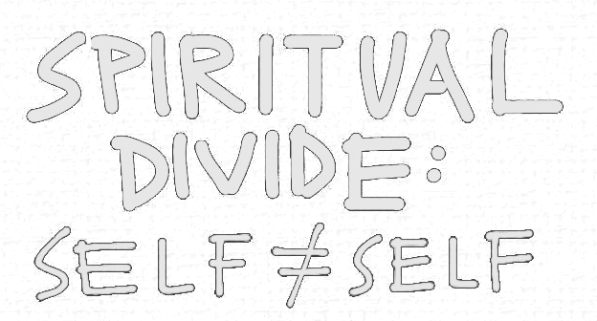

Slide 6
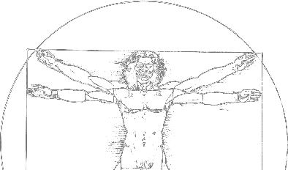

Slide 7
1. Co-initiating: uncover common intent stop and listen to others and to what life calls you to do
2. Co-sensing: observe, observe, observe connect with people and places to sense the system from the whole
4. Co-creating: prototype the new in living examples to explore the future by doing
Co-strategising:
Stop, Reflect and Remind one another about why this matters

Slide 9
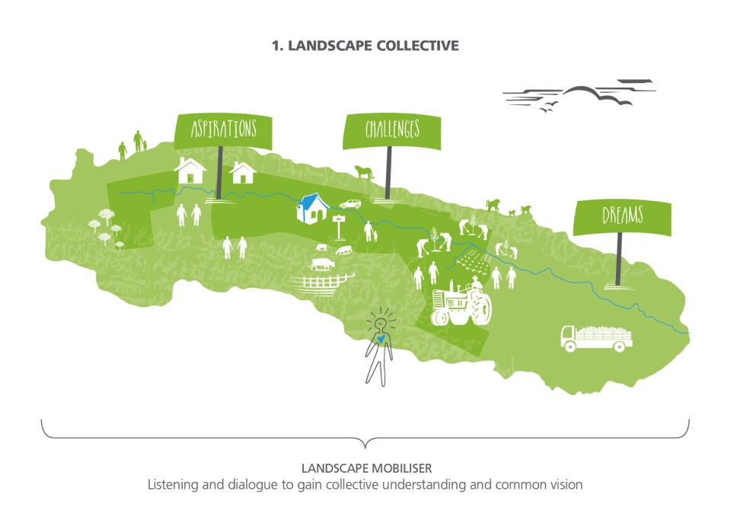
Through landscape mobilizing social, cultural and a mindset change can be initiated
Social Leverage Points
Lack of collective story and identity
Lack of pilot Projects
Cynicism around Green Movement & ecological change
Lack of understanding around collective responsibility & interdependence
Lack of action learning culture
Solutions emerge from past not based on shared future/values
Lack of collaborative leadership & shared responsibility
Lack of drive for change
Challenge of the commons

Slide 10
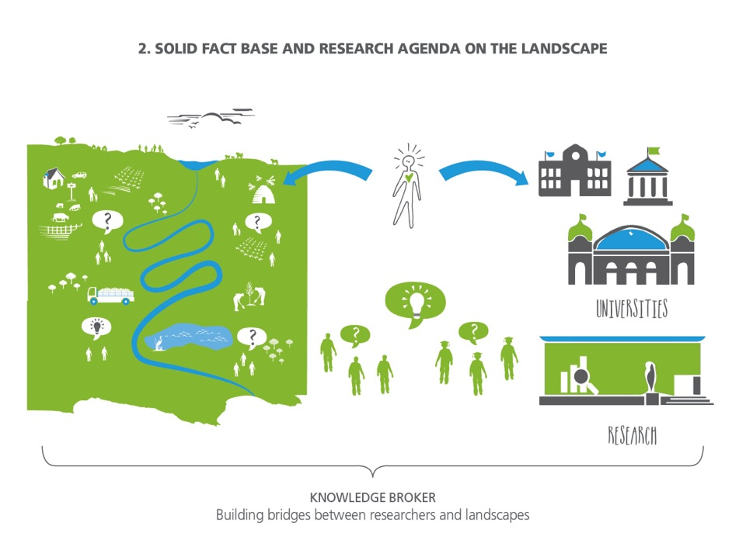
Knowledge systems are key leverage points for landscapetransformation.
Knowledge Leverage Points
Lack of knowledge for decision making tools and complex thinking around restoration
Lack of clear Business Case
Lack of Restoration Knowledge, Tools & Practical Know-how
Lack of scientific knowledge that supports restoration
Lack of a Collective Strategy for restoration
Lack of understanding of Ecosystems

Slide 11
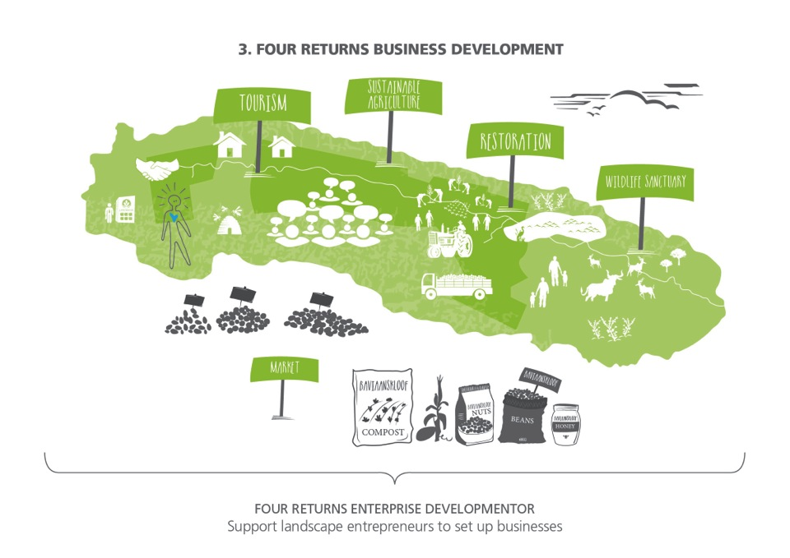
Through landscape enterprise and value change develop the economic barriers will be addresses to improve livelihoods, decrease land pressure and make land available for restoration.
Economic Leverage Points
Lack of understanding of Economic Impact
No funding for opportunity costs
Farmer’s existing financial burden and Debt
·Lack of Interest by investors in Restoration
Bad market incentive
Long transition time
Ownership on natural resources
Land Ownership/Tenure

Slide 12
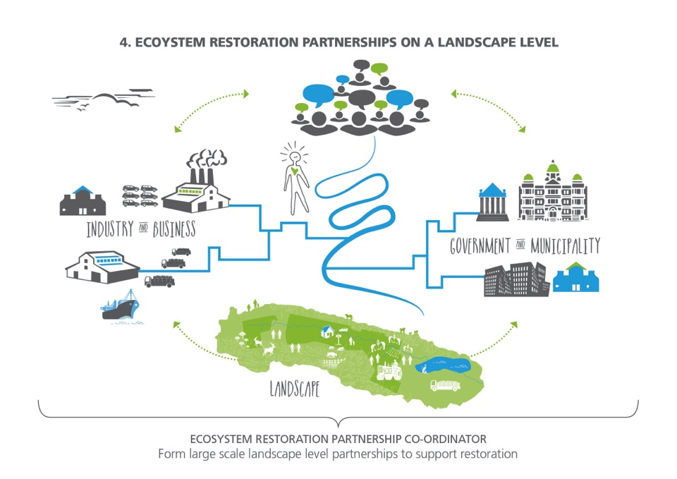
Through regional social-labs restoration partnership will be created to in g business and government together to create an enabling environment for new policy, change in value chain, CSI investment, water bonds and also larger investments.
Governance Leverage Points
Poor/Perverse policy development
Top Down Governance Structures
Lack of incentives and subsidies
Lack of Integrative Governance Structures
Need for Co-creative Policy Development
A key strategic objective is to innovate the governance structures of a region to support restoration initiatives and in the longer term, the creation of restoration economies.

Slide 13
Integration of ecosystem understanding in business Leadership and strategy

Slide 14
