Slide 1
Brainstorming on the Financing Model
Use the drawing toolsand brainstorm your financing model on this canvas
Your Activities | Which costs will occur with these activities? | What are your own resources? | Which income sources do you have?
 |  |  | Short Term | Mid term

Slide 2
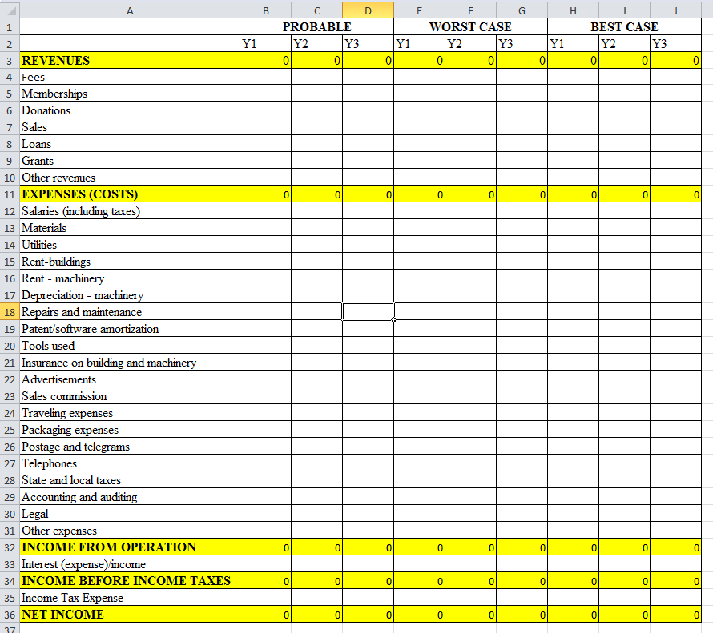
Simplified Financial Statement in Excel
→ you can download this file via this link: https://ilias.hfwu.de/goto.php?target=cat_23201&client_id=hfwu

