Slide 1
Tutored Session 6 – 24.04.2019
Goals of this tutored session:
Make your business idea(s) explicit
Start working with the business canvas template on your own business idea
Help the members of your international teams in completing the template for their business idea
Reflect on the process in the plenary

Slide 2
Agenda for the tutored session:
Plenary 16 00 – 16 15:
Collect status quo with regard to your business ideas
Working groups 16 15 – 17 15
Working teams split up and work with the business canvas template
Complete one template per business idea
Make sure you keep a snapshot of your results
Plenary 17 15 – 17 30
Discuss remaining questions

Slide 3
Plenary: On which business ideas are you going to work?
Note: Students going on an IP will develop the business plan with their groups during the IP, but they can use a fictive case/challenge for the upcoming exercises. Students not going on an IP will develop the business plan (assignment 3) on the case they have chosen now.
Team | Name(s) | Business Idea

Slide 4
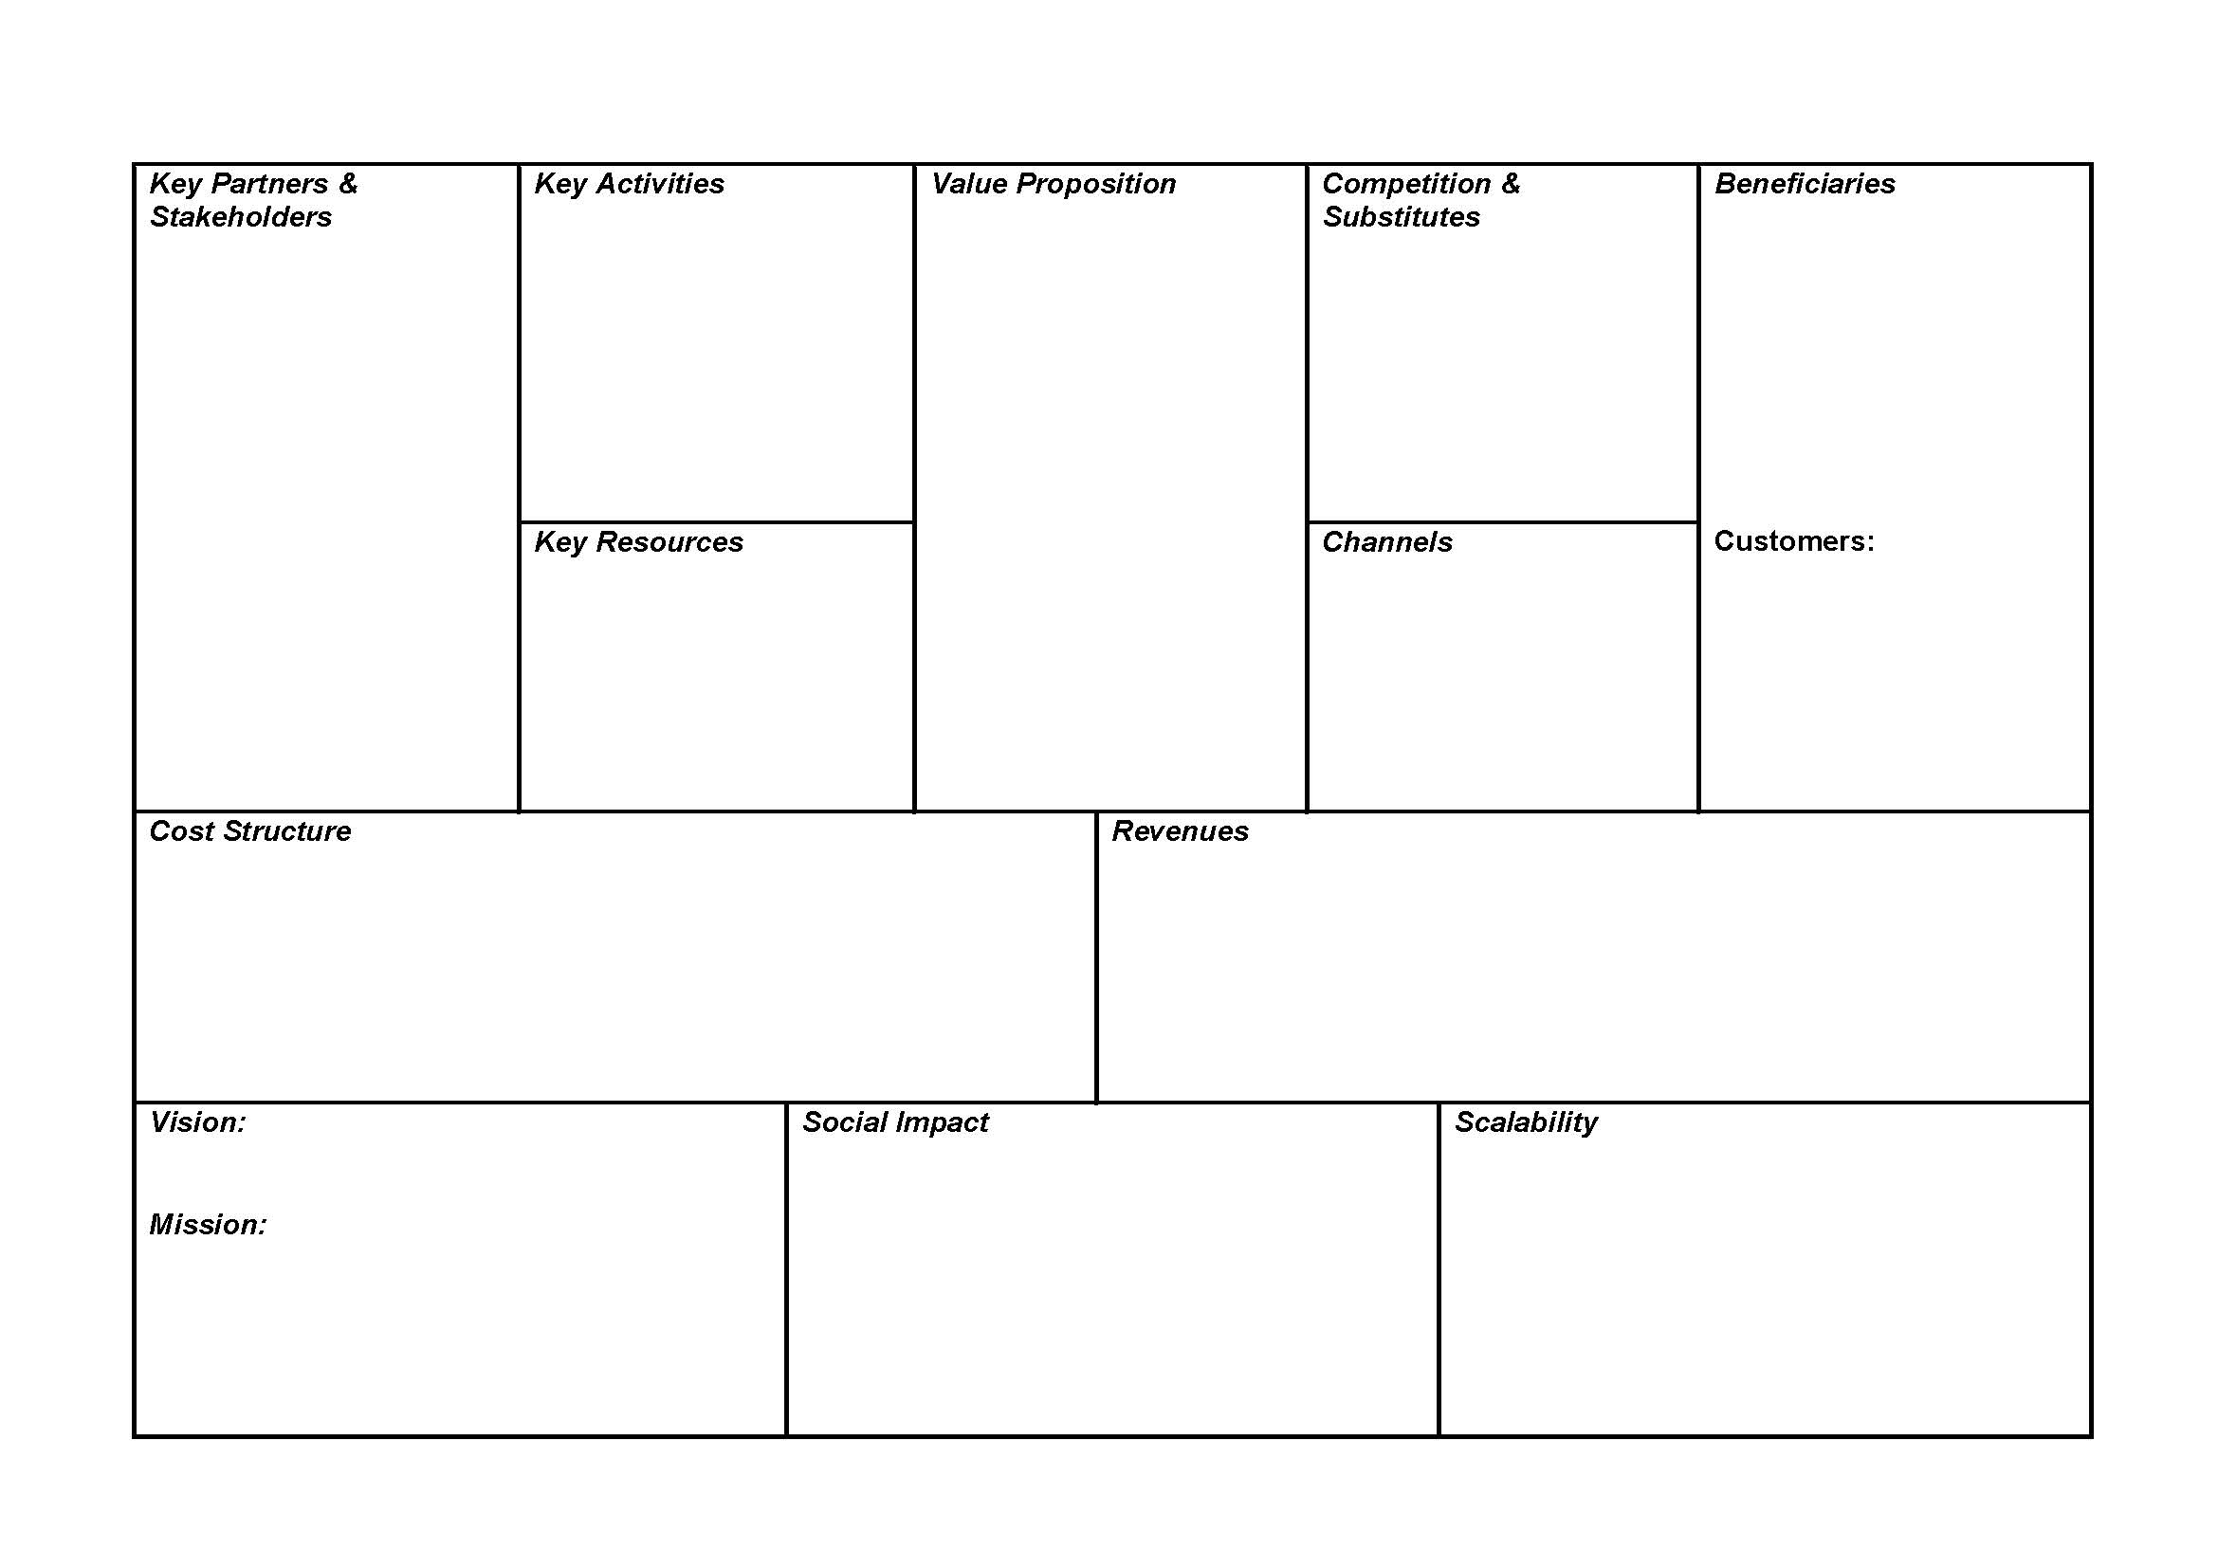
Template Business Idea 1
Use the drawing tool and brainstorm your business idea on this canvas. Use one canvas per business idea.
Name of your business idea:______________________

Slide 5
Template Business Idea 2
Use the drawing tool and brainstorm your business idea on this canvas. Use one canvas per business idea.
Name of your business idea:______________________

Slide 6
Template Business Idea 3
Use the drawing tool and brainstorm your business idea on this canvas. Use one canvas per business idea.
Name of your business idea:______________________

Slide 7
Plenary
Are there any remainig questions with regard to the business canvas?

Slide 8
Upcoming activities and sessions
Watch the preparatory recordings on Financing Model until April 30:
https://ilias.hfwu.de/goto.php?target=cat_23201&client_id=hfwu Social Entrepreneurship Business Models Tuesday, April 30, 16 00 – 17 30 CET Financing the Social Entreprise, Monica Dudian, Carmen Paunescu
Cooperation Management, Dirk Funck
Presentation of the Business Plan Template
Tutors and teams online session Thursday, May 2, 16 00 – 17 30 CET Financial modeling exercise May 5 → IP teams depart, no lecture sessions until May 21
Additional tutor sessions: Thursdays May 9 + 16

