Slide 1
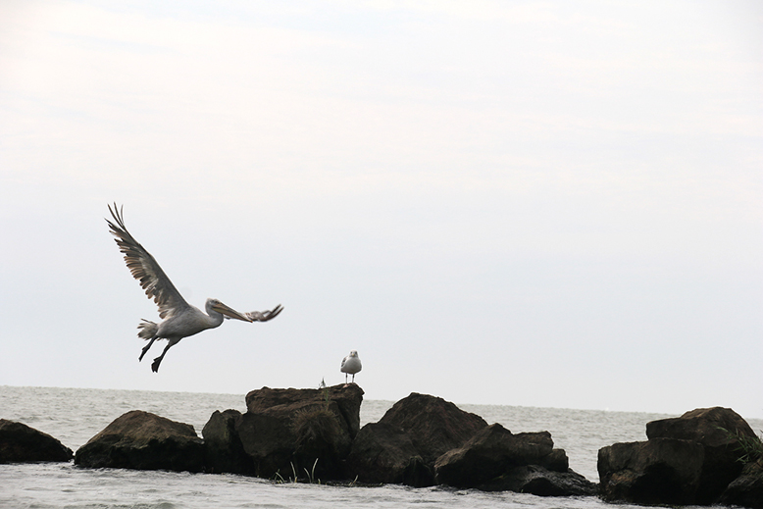
Landscape Evaluation
and Assessment
Friday, March 20, 2020
Location:xxxxxxxxxxx
Group members:
Xxxxxx, yyyy, xxxx…..

Slide 2
Presentation guidance
Each team presents its findings on 9 slides according to the structure of this template
Do not switch to wide-screen PPT formats (no proper display in Adobe Connect)
You have one minute presentation time for each slide, sometimes two minutes
Make sure that you introduce yourself before you start preseting
Each team member needs to present a part of it
Make sure that you have a coherent sequence, you should do a rehearsal in advance
Make sure that everyone has a functioning microphone/headset
You can practice in advance in your team room
Your total presentation time is 20 minutes. 10 min presentation + 10 min discussion. Make sure that you keep the time limits, you will otherwise be stopped by the moderator.
Your presentation will be evaluated, it is a compulsory part of the assignment.

Slide 3
Your Assessment Strategy
What are the goals of your assessment?
Why are these goals relevant (briefly link back to your system analysis)
Which themes have you mapped (the idea was to map at least three different topics)?
1 minute

Slide 4
Mapping Theme 1
Show your mapping outcomes and main findings
You may use an additional slide for each theme but take care that the overall presentation time is kept

Slide 5
Mapping Theme 2
Show your mapping outcomes and main findings
You may use an additional slide for each theme but take care that the overall presentation time is kept

Slide 6
Mapping Theme 3
Show your mapping outcomes and main findings
You may use an additional slide for each theme but take care that the overall presentation time is kept

Slide 7
Assessment synthesis
Show a synthesis of your assessment process for example in the form of a problems/risks – potentials map

Slide 8
Your priorities and targets
Based on your assessment findings , which goals would you now define for your planning and design process?

Slide 9
Critical reflection
Which limitations have you encountered during the landscape assessment phase?
Which major insights did you get from the lectures/readings?

