Slide 1
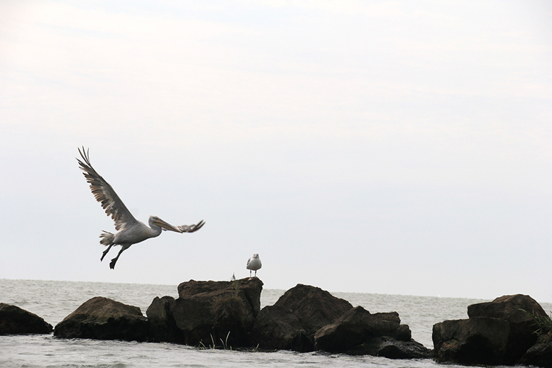
Landscape System Analysis
Friday, April 5, 2019
Location:xxxxxxxxxxx
Group ID:xx
Group members:
Xxxxxx, yyyy, xxxx…..

Slide 2
Presentation guidance
Each team presents its findings on 9 slides according to the structure of this template
Do not switch to wide-screen PPT formats (no proper display in Adobe Connect)
You have one minute presentation time for each slide, sometimes two minutes
Each team member needs to present a part of it
Make sure that you have a coherent sequence, you should do a rehearsal in advance in your Adobe Connect Room
Make sure that everyone has a functioning microphone/headset
Your total presentation time is 25 minutes. 15 min presentation + 10 min discussion.
Make sure that you keep the time limits, you will otherwise be stopped by the moderator.
Your presentation will be evaluated, it is a compulsory part of the assignment.

Slide 3
Rationale
Here you present one key visual/2-3 keywords of your area
Explain why this case is relevant (orally)
What is your hypothesis for this place? (orally)
1 minute

Slide 4
Coastal Typology
Explain/visualise the typology of your coast with reference to ist geological foundation/context
1 minute

Slide 5
Land use development
Show with maps which land uses are predominant and how did the uses change in time?
Which uses are predominant (orally)
Which land uses are likely to predominate in the future? (orally)
2 minutes

Slide 6
Green + Blue Infrastructure
Show with maps which are the main blue-green infrastructure elements in your coastal landcsape
1 minute

Slide 7
Power map
Show a power map of your understanding which actors are predominating the landscape – and who is highly affected but without power
1 minute

Slide 8
Sacred Spaces and Heritage
Which spaces/elements hold symbolic meaning? Show with maps and pictures/drawings
1 minute

Slide 9
Landscape Narrative
Which stories are embedded in your landscape?
Who has written about it?
Who has painted it? Show with images and sketches
1 minute

Slide 10
Your System Analysis
Give a graphical overview:
Which driving forces are influencing your landscape system?
Which pressures emerge from them?
What is the impact on the landscape system and it elements?
You can use a DPSI(R) model or a Spider Diagram for synthesizing
Max 2 minutes explanation time

Slide 11
Your hypothesis
Visualise with a graphic what you think will happen to this landscape if all the driving forces just continue as they do.
1 minute

