Slide 1
Social Entrepreneurship for Local Change Assignment 5 Template for Business Model Canvas report
Working Group: x
Group members:
xxx
xxx
xxx
xxx
etc.

Slide 2
Template for Assignment 5 – Business Model Canvas
This assignment consists of a further developed business model for your „Innovation Idea“ presented on June 9th.
We expect the following content
Summary of the business model in the Business Model Canvas (one page).
In deep explanations for one example each for the nine key elements of the canvas (one chart each)
Please use this template for your group report. Date of submission:
31.05.2020 (ASE)
21.06.2020 (all others)
This is just a content framework. Feel free to give it your personal touch. Graphs, fotos, pictograms etc. are most welcome.

Slide 3
(Social) Enterprise or charity / community based organizations
Mission Statement
Key-Partners
Key Processes
Value Proposition
Key-Products &
-Services
Customers
Beneficiaries
Key Resources
Channels
Cost-Driver
Revenue-Driver
Customer & Beneficiary Input
KPI (Key Performance Indikator)
Social & Environmental Impact / Impact for Benficiaries

Slide 4
Guideline for the Social Business Model Canvas
(Social) Enterprise or charity / community based organizations: „name“, „legal form“, „location“, „founding year“, „founders“, „main field of activities“„no. of employees“. Note: This canvas can also be used for describing, analysing and developping business modells for more charity and community based orgainsations as long there are costs to cover and revenue streams to secure.
Mission Statement: company's purpose as a way of unifying the organization. A combination of what your business or nonprofit does and how and why it does it, expressed in a way that encapsulates the values that are important to you. Example: “Fair Collection”: We employ disadvantaged people in developing countries. Together we create and sell jewellery - providing dignified wages and holistic social programs.
Key-Partners
Which partners, who are not in the direct sphere of influence of the company are important for the success?
Examples: central suppliers, advertising online platform, municipality, donators, politicians, …
Key Processes
Which processes are of central importance for the value creation of the company?
Examples: recruiting, training & education, crowd funding,
Value Proposition
What characterizes the value added of the company?
What makes it "different“ / "special"? Why do customers become "fans"?
What are the special benefits you create for the customers / beneficiaries?
Example: “Fair Collection” We create and sell attractive genuine and costume jewellery.
Key-Prod. & -services
Which activities & services inspire the customers and help to win/retain them?
Examples sustainbility-standards, levels of creativity & innovation
Customers
Who do you address?
Criteria to describe the target group: demo-graphic, socio-economic psychographic, market behaviour
Personas help to explain the target group more comprehensibly
Beneficiaries
See customers
In addition: What are their needs, why are they in need
Key Resources
Which (in)tangible input factors determine the success of the SE.
Examples: data, know-how employees, brand reputation,location, support of volunteers
Channels
Which ways to your customers do you use and combine?
Examples: Shop, online-shop, social media, platforms, weekly markets
Cost-Driver: What are the most important cost items? Which ones have a strong dynamic? Which ones can be decisively influenced? (raw material, rent, online marketing, personnel, interest, ...)
Income-Driver: What are the most important sales drivers? Which ones have a strong dynamic? Which ones can be decisively influenced? (products, services, online shop, events, donations, …).
Customer & Beneficiary Input: In what way do customers and / or beneficiaries contribute to the value creation? (Examples: acceptance of higher prices or unconvenient processes, supporting compaigns, ...)
KPI (Key Performance Indikator): With which key figures do you want to measure the success? Link them to your mission statement and value proposition as well as to different areas of the company (e.g. finance, customers, development, processes, resources).
Social & Environmental Impact / Impact for Benficiaries: Which effects does the companies work have on the Sustainable Development according to UN SDG and with regard to the beficiaries needs (payment, education, health, quality of live, participation, …)

Slide 5
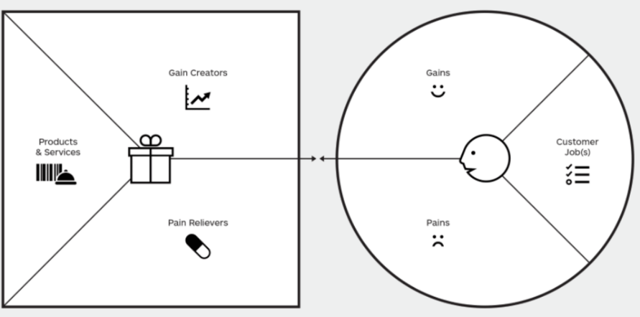
Value Proposition (1 chart)
Use the value proposition canvas to explain what makes your business model unique.
outcomes
gain creators
gains
benefits
desires
needs
products &
services
customer
jobs
tasks
risks
costs
problems
pain releavers
pains
time
Tutorial: https://www.youtube.com/watch?v=D254suPMpwY&t=192s

Slide 6
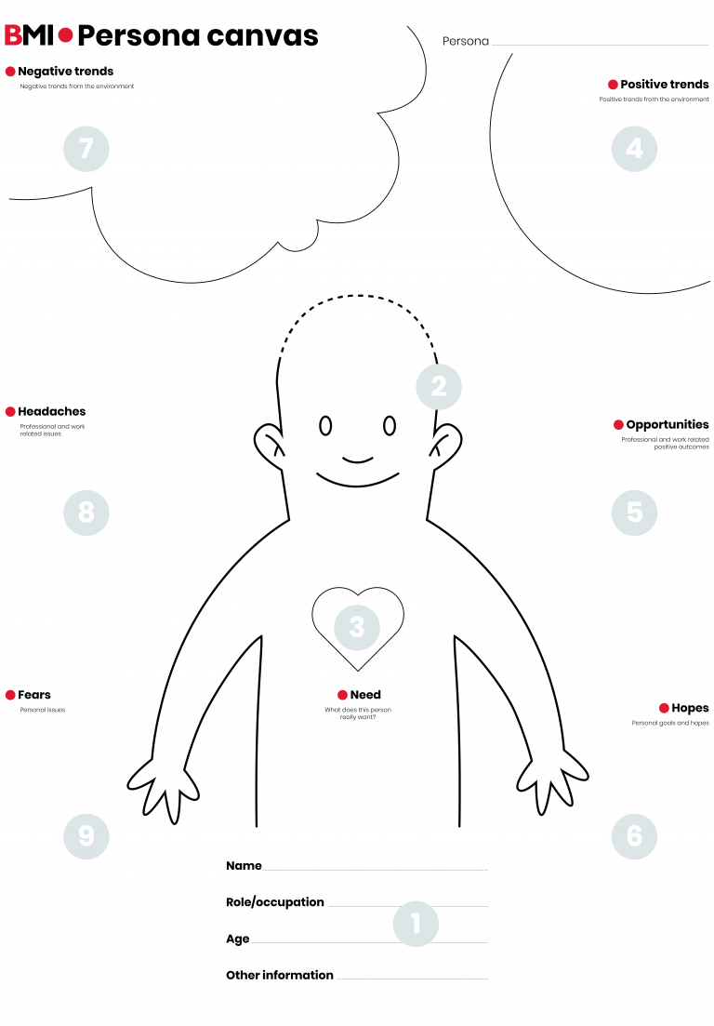
Customers & Beneficiaries (2 charts one for each persona)
Develop a persona for a typical customer and a typical beneficiary.
This persona canvas is just an example
You are also welcome to use another one.

Slide 7
Key-products and -services (1 chart)
Explain the most important products or services to inspire and win/retain customers. What is the particular benefit for your target group?

Slide 8
Channels (1 chart)
Develop a diagram of your Multi-Channel-System to get in touch with your customers and to sell your products and services.

Slide 9
Key-Processes (1 chart)
Develop a diagram of one of the key-processes of your business model.

Slide 10
Key-Resources (1 chart)
Describe one of the key-resources of your business model. How can you ensure that this resource is permanently available and will be developed further?

Slide 11
Key-Partners (1 chart)
Describe one of the key-partners of your business model. How can you ensure that this partner will cooperate with your organization? Which target conflicts might arise?

Slide 12
KPI: Key-Performance-Indicator (1 chart)
Define and explain three KPI to measure the success of your business model according to your mission statement and value proposition.

