Slide 1
Session Structure
All teams find a financing brainstorming model in the parallel rooms, tutors move team members to the parallel rooms
 | Plenary | Breakout 1 | Breakout 2
People | Team 1 Tabea Martijn Claudia-Mariana | Team 2 Olivia Oana Catalina Waithira | Team 3 Cornelia Tosca Elena
Process
16 00 – 16 20 | Plenary Discussion on Financing Models and Income Sources
16 20- 16 45 | Discussion with Daan | Discussion with Katharina | Team discussion with financing brainstorming
16 45 - 17 10 | Team discussion following the script | Team discussion following the script | Discussion with Daan/Katharina
17 15 – 17 30 | Debriefing in the plenary

Slide 2
Script for the brainstorming session
Duration: 1 hour including 20 minutes interaction with the tutor Organisation: Decide who is going to moderate this session. Decide who is going to take notes
The drawing tool is activated – you can add your ideas directly to the slide
Objective of the session: Specify your activitites, expenditures/costs and potential income sources
Activities:
Brainstorming on the basis of the financing brainstorming sheet, you can also come back to the business canvase
Saving your results:
Save your notes and screenshots
Next steps after this session:
Continue your group discussions
Download the business plan documents with the simplified financing sheet
https://ilias.hfwu.de/goto.php?target=cat_20429&client_id=hfwu
Make it a shared document for your team on google or similar
Start the collaborative thinking/writing process

Slide 3
Brainstorming on the Financing Model
Use the drawing toolsand brainstorm your financing model on this canvas
Your Activities | Which costs will occur with these activities? | What are your own resources? | Which income sources do you have?
 |  |  | Short Term | Mid term

Slide 4
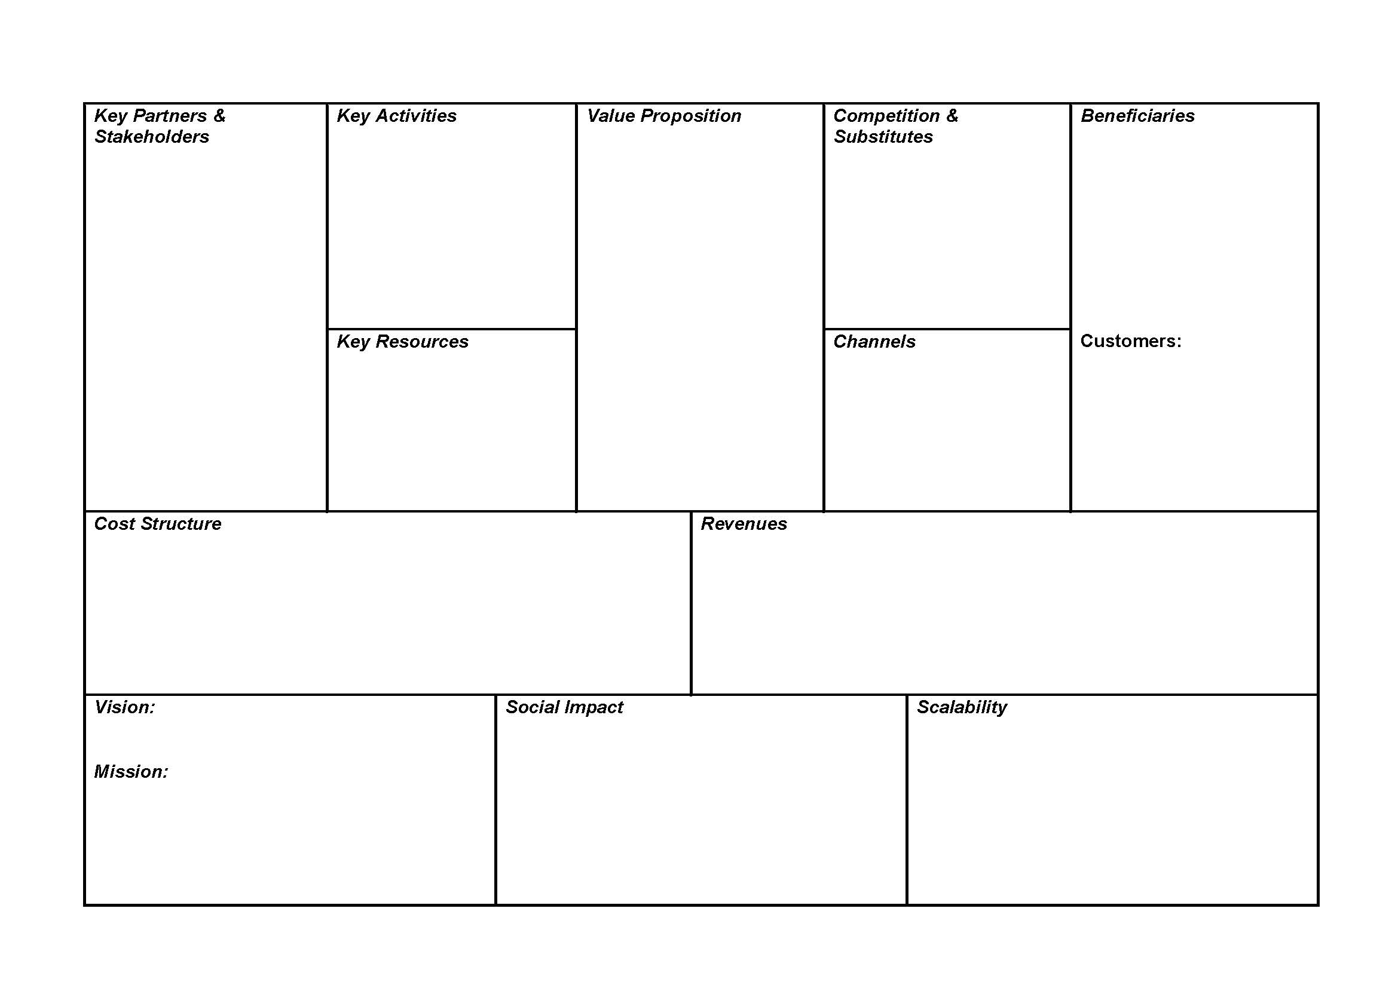
Social Business Canvas
Use the drawing toolsand brainstorm your business model on this canvas

Slide 5
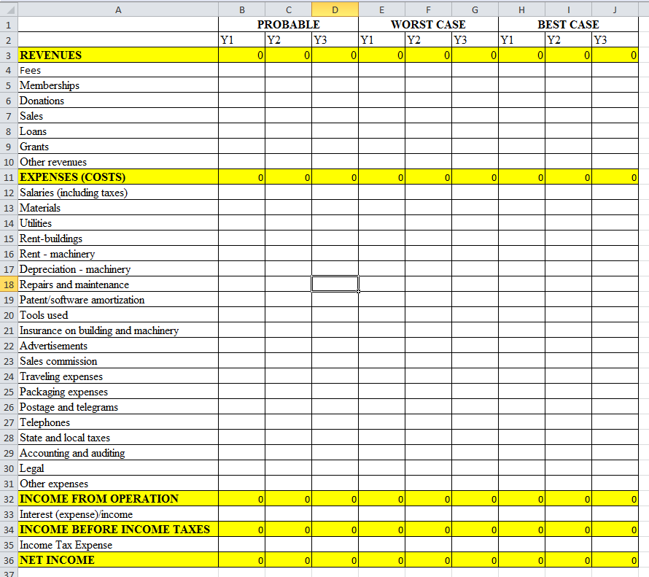
Simplified Financial Statement in Excel
→ you can download this file from the file sharing pod or via this link: https://ilias.hfwu.de/goto.php?target=cat_20429&client_id=hfwu

